Slide 1

Machine Learning Construction in NL
Project 5
June 6, 2020
Sreelatha chunduri

Slide 2
Storyline
11 Data SETS
scope: only BUILDINGS & no infrastructure projects
different types of buildings, construction phases & COST of construction

Slide 3
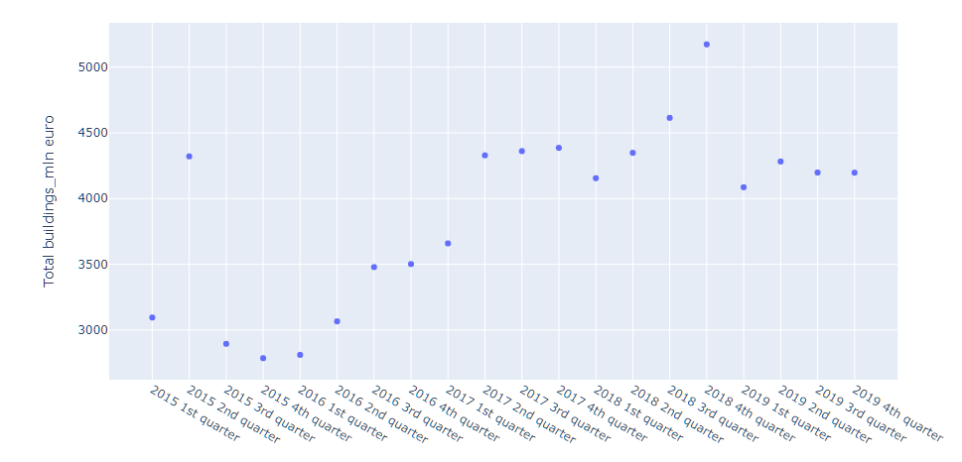
Total costs of all buildings in NL from 2015 - 2019
It includes buildings such as,
Dwellings
Offices
Combined company halls
Halls and warehouses
Agricultural sheds and stables
Shops
Schools
Other Buildings
In the past 5 years, 2018 had the highest peak in new buildings construction costs
About 5500 million euros were spent in NL on construction

Slide 4
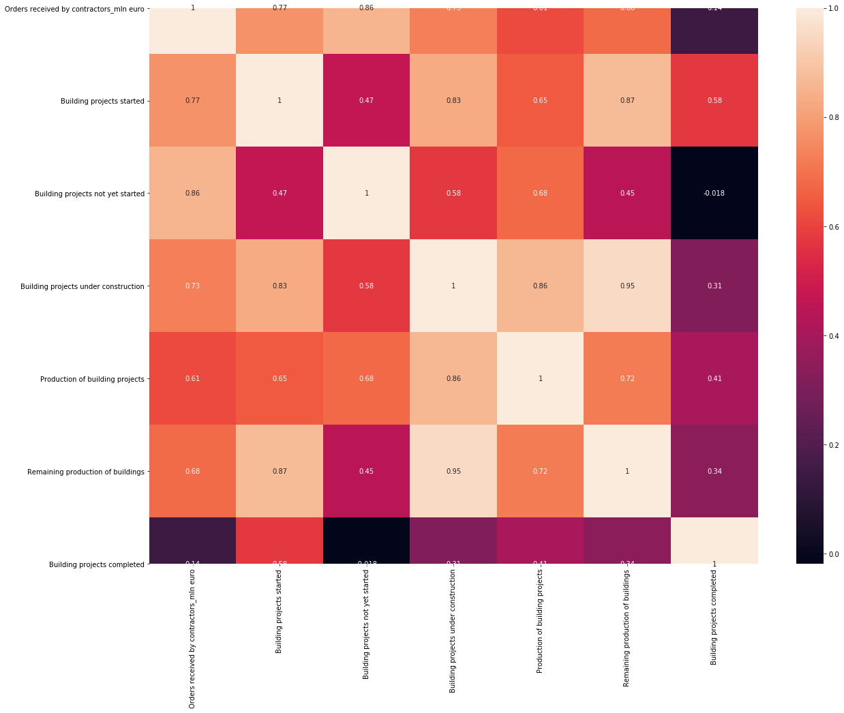
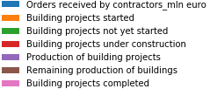
Correlation

Slide 5
Correlation
There is a positive correlation between:
"Production of building projects" and "Building projects under construction“ - This makes complete sense.
"Building projects started" and "Remaining production of buildings“ -I think this correlation says that there is a continuous demand for buildings and the construction is a continuing.
"Orders received by contractors_mln euro" and "Building projects not yet started“ - This probably says that there is a backlog in the construction activities.

Slide 6
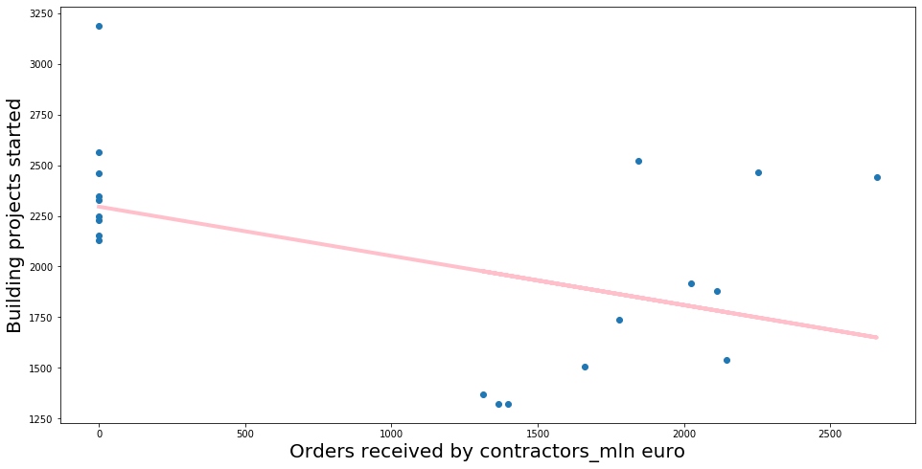
Data Cleaning

Slide 7
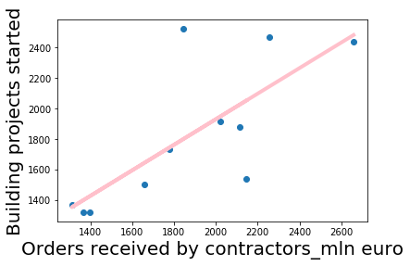
Building a Regression Model
It is clear that the "Orders received by contractors_mln euro" is a good predictor of "Building projects started".
The pink line in the plot is the regression line – the predicted variables based on the data.

Slide 8
Modeling, Prediction, and Evaluation
Supervised Learning
Linear Regression
K-nearest Neighbor
Unsupervised Learning
K-Means Clustering

Slide 9
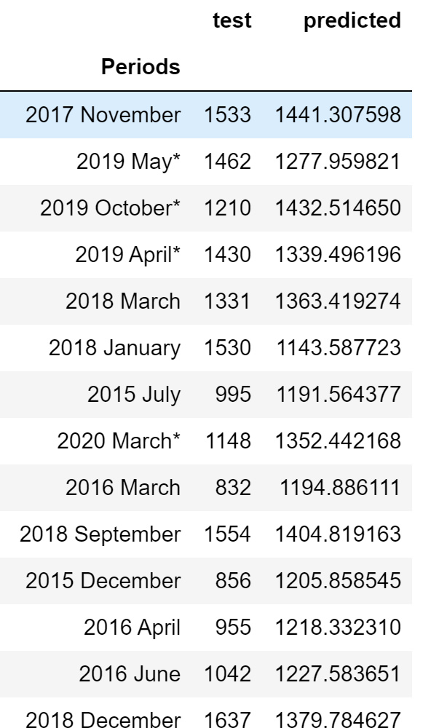
Supervised Learning - Linear Regression
R2 Score - coefficient of determination: Best possible score is 1.0 and it can be negative (because the model can be arbitrarily worse).
Evaluating the model with the train data
r2_score = 0.2578
Evaluating the model with the test data
r2_score = -1.01402
The r2 score for the test data is a negative value which shows that model can be arbitrarily worse.

Slide 10
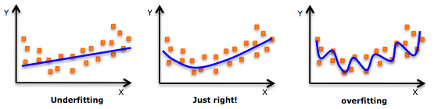
Conclusion
I think this model is overfitting.
My model has a high R2 because it's fitted to non-predictive noise in my training data and consequently doesn't generalize well
Hence the low accuracy on my test set
Solution: More data and Regularization (bringing in more features)

Slide 11
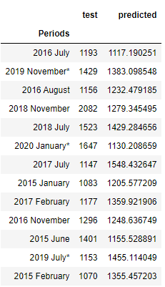
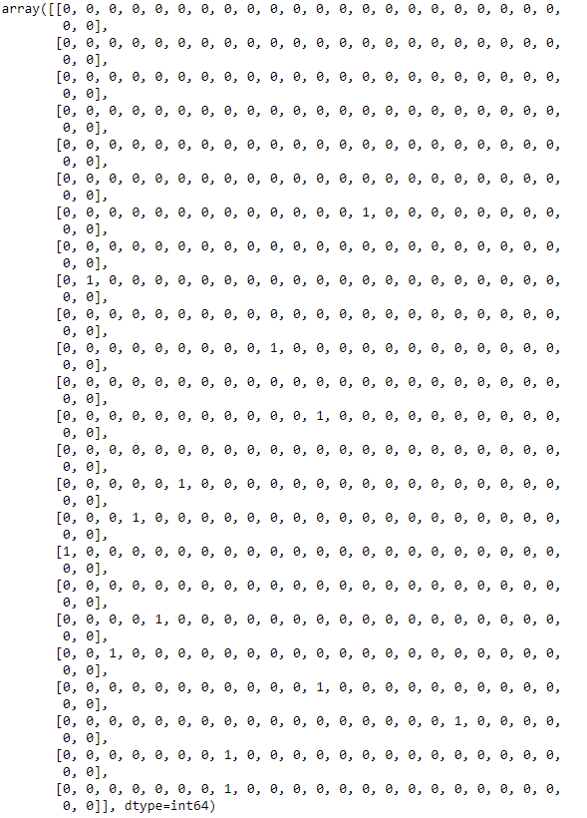
Supervised Learning - K-nearest Neighbour
Accuracy Score = 0.0 Confusion Matrix:

Slide 12
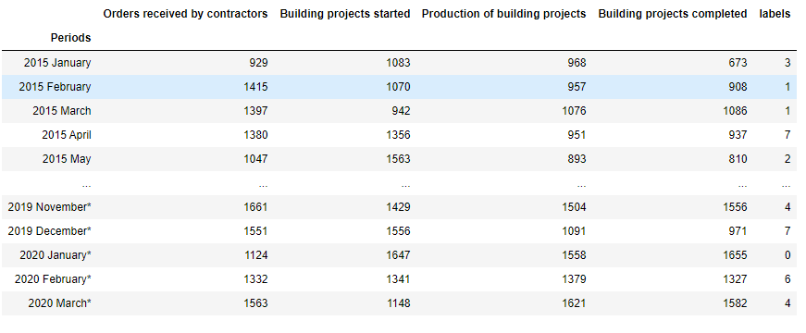
Unsupervised Learning - Data Clustering with K-Means

Slide 13
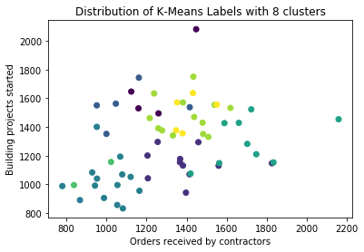
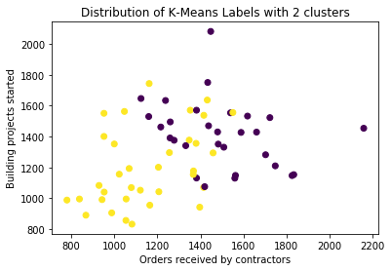
Unsupervised Learning - Data Clustering with K-Means

Slide 14


